Slide 1
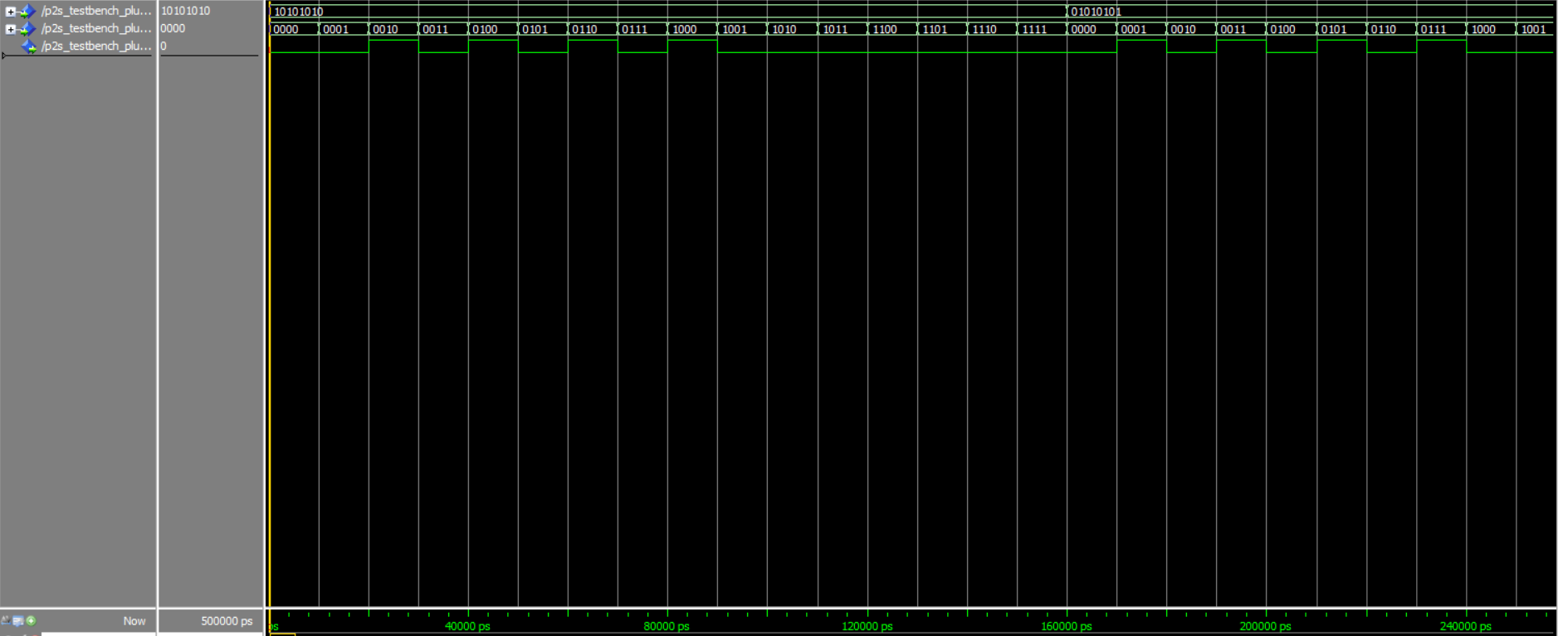
0 1 0 1 0 1 0 1 1 0 1 0 1 0 1 0

